Slide 1

E-commerce Data Analysis Project (OLIST)
By Anas Zerrabi

Slide 2
Tools and data used
Data Source: Kaggle's Brazilian E-Commerce Public Dataset (Olist).
Analysis Tools:
Google BigQuery : To process and analyse data using SQL queries.
Power BI: To design an interactive dashboard and visualize results.

Slide 3
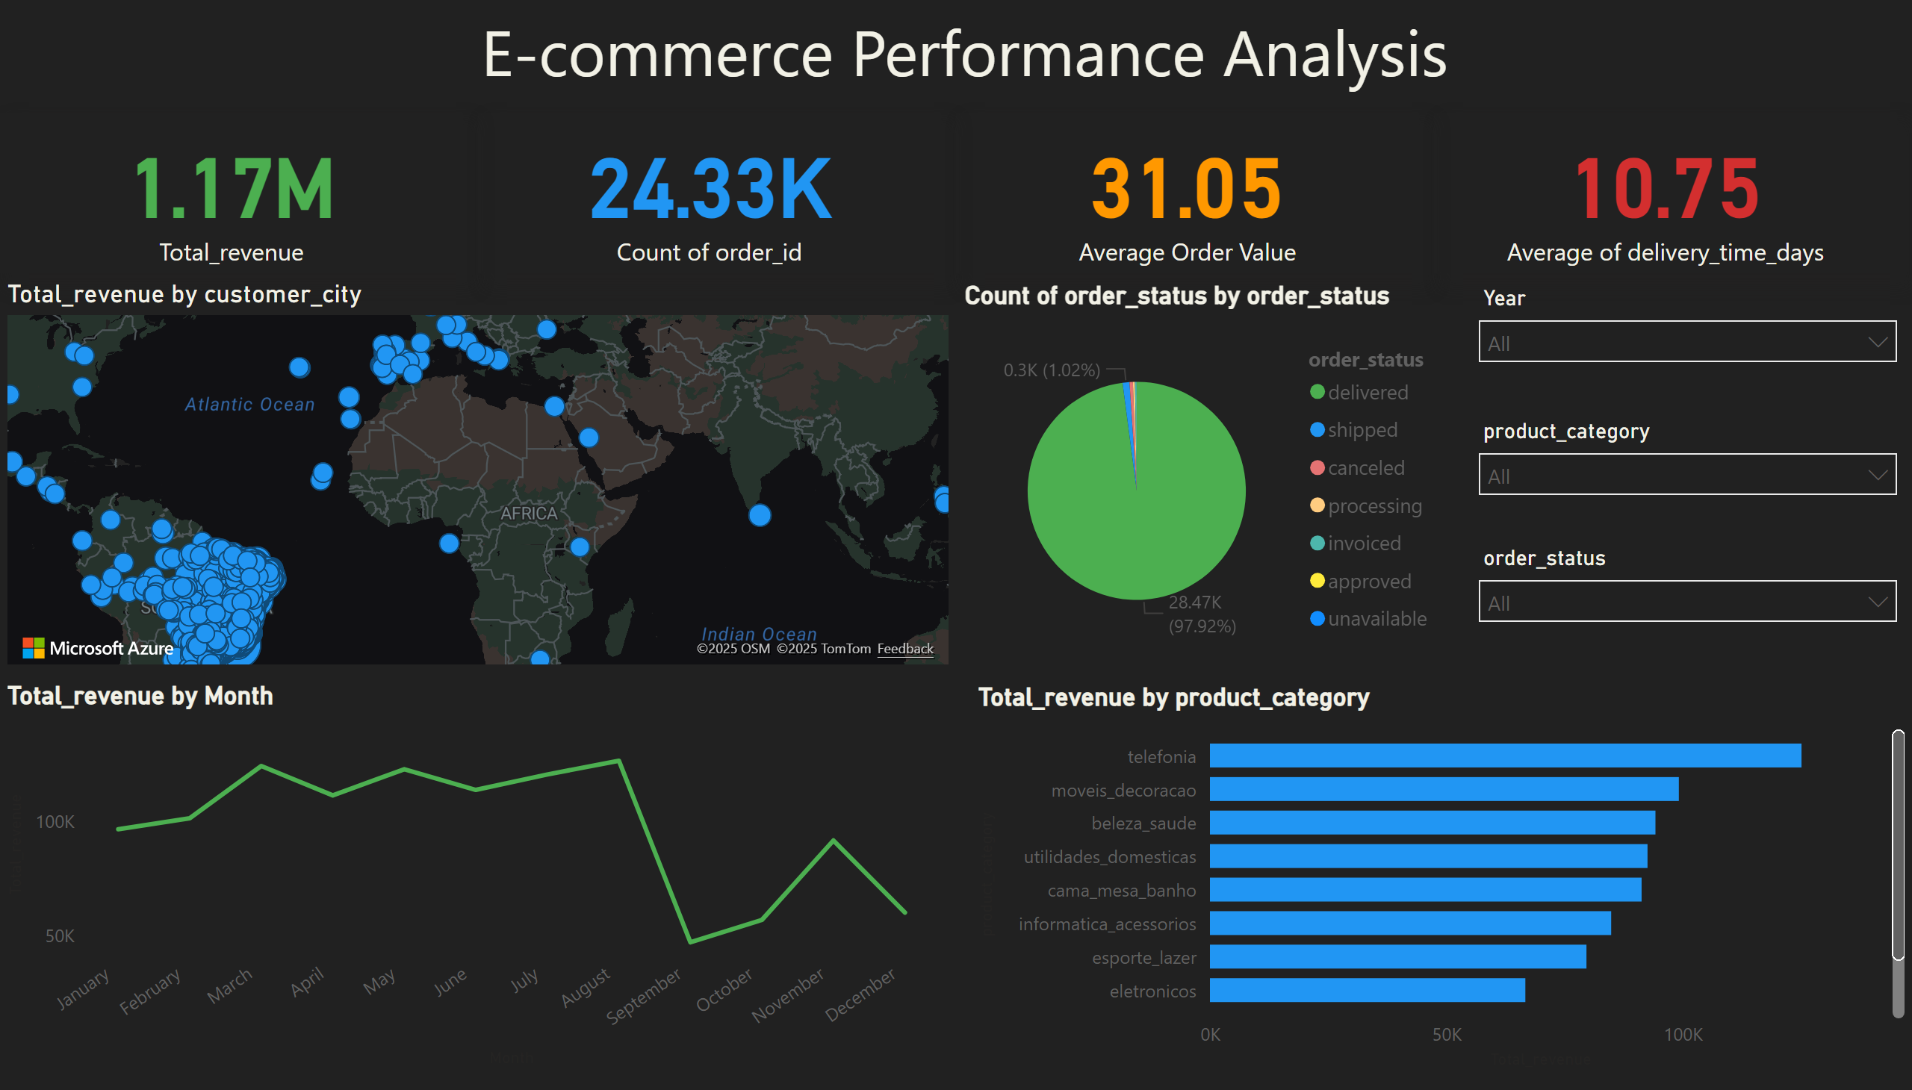

Our Projected Sales

Slide 4

The results and insights derived can be summarized as follows:
Key financial results
Sales performance and trends
Insights into Operations
Geographical distribution

Slide 5
Key financial results :
Total Revenue: Total sales revenue amounted to 1.17 million, reflecting the company's strong financial performance during the period under analysis.
Number of Orders: Over 24,330 orders were executed, demonstrating a large volume of transactions and an active customer base.
Average Order Value (AOV): The average order value is 31.05, an important indicator of a customer's average spend per transaction.

Slide 6
Sales performance and trends :
Monthly Trends: The monthly revenue analysis shows a clear seasonal pattern, with sales peaking in March and August, then declining significantly in the final months of the year. This insight helps understand seasonal fluctuations and plan for the future.
Top-selling product categories: The dashboard reveals that the telephones (telefonia) and furniture and decor (moveis_decoracao) categories generate the most revenue, indicating that they are the most popular categories among customers.

Slide 7
Insights into Operations :
Order Status: The data indicates high order fulfillment efficiency, with approximately 98% of total orders successfully delivered, reflecting the company's efficient supply chains and logistics.
Delivery Time: Although the card displays the total number of delivery days (306,000 days), the most important metric to analyse is the average delivery time, a key indicator of customer satisfaction and shipping efficiency.

Slide 8
Geographical distribution :
Global reach: The map shows that sales are largely concentrated in South America, specifically Brazil, with some limited sales in other parts of the world, confirming that the Brazilian market is the company's core market.

Slide 9
Thank You
zarab99999@gmail.com

